Slide 1
M.Tech DSE Machine Learning (DSECL ZG565 )
Dr. Monali Mavani
Source Slides of Prof. Chetana from BITS Pilani and many others who made their course materials freely available online.

Slide 2
Agenda
Bayes optimal classifier (T1 book by Tom Mitchell - 6.7)
Gibbs Algorithm (T1 book by Tom Mitchell - 6.8)
Naïve Bayes Classifier (T1 book by Tom Mitchell - 6.9)
Gaussian Naïve Bayes Classifier
Applications
Text classification model (T1 book by Tom Mitchell - 6.9)
Image Classification
Minimum Description Length (MDL) Principle (T1 book by Tom Mitchell - 6.6)
Decision Theory (R1 book by Christopher Bishop - 1.5)

Slide 3
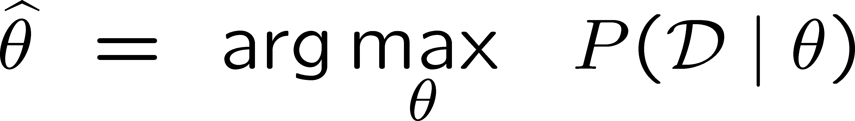
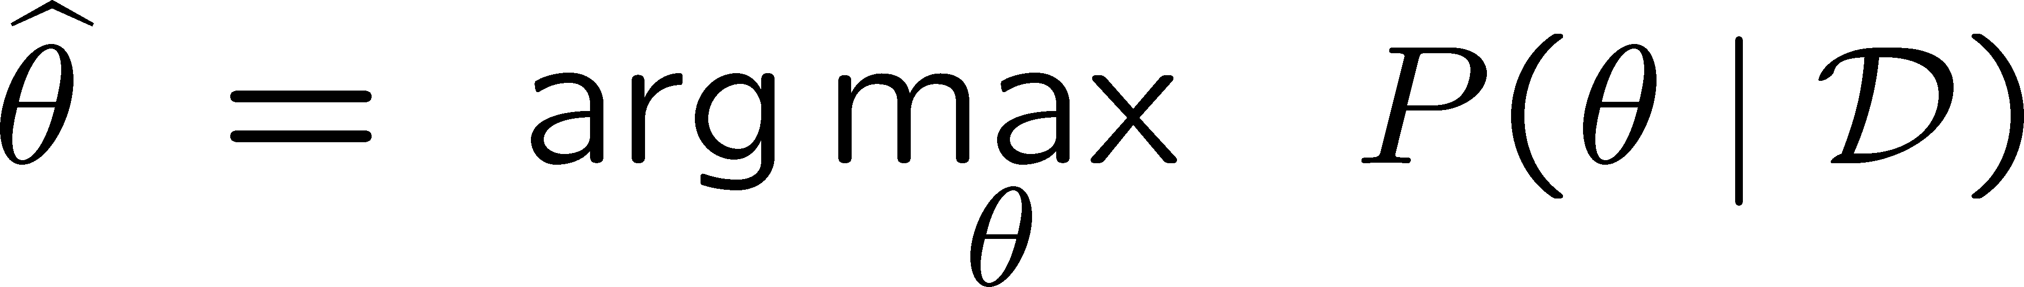
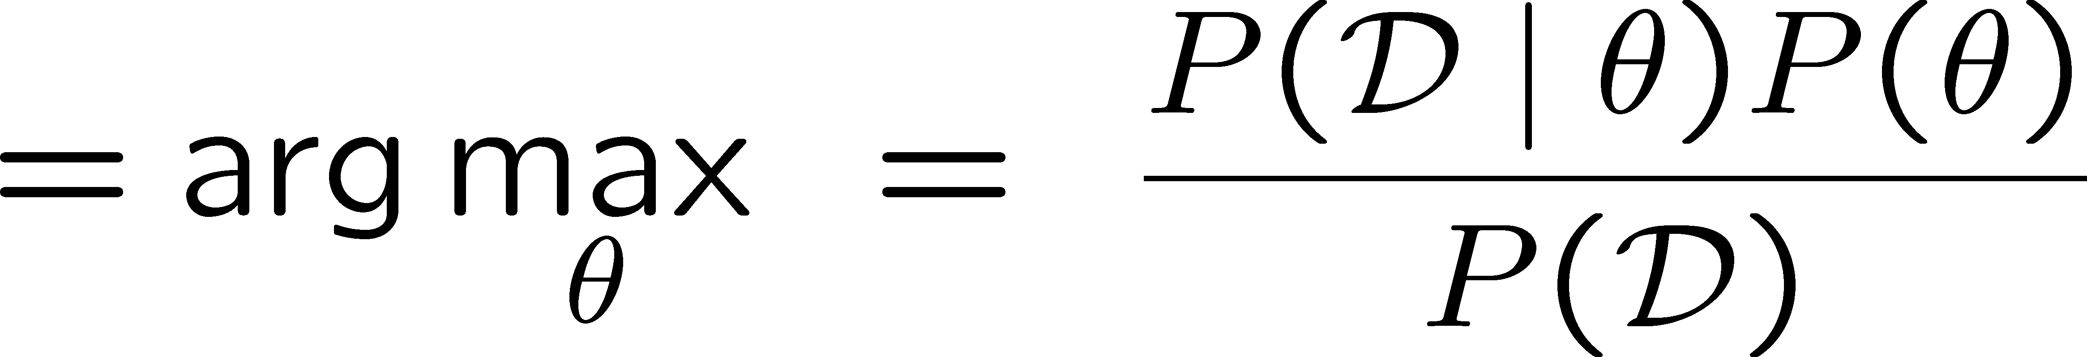
Two Principles for Estimating Parameters
Maximum Likelihood Estimate (MLE): choose θ that maximizes probability of observed data D
Maximum a Posteriori (MAP) estimate: choose θ that is most probable given prior probability and the data

Slide 4
Most Probable Classification of New Instances
So far we’ve sought the most probable hypothesis given the data D (i.e., h_{MAP})
Given new instance x, what is its most probable classification?
h_{MAP}(x) is not the most probable classification!
Consider:
Three possible hypotheses:
P(h₁|D) = .4, P(h₂|D) = .3, P(h₃|D) = .3
Given new instance x,
h₁(x) = +, h₂(x) = −, h₃(x) = −
What’s most probable classification of x?
and

Slide 5

Bayes’ Optimal Classifier
The most probable classification of the new instance (or the label produced by the most probable classifier) is obtained by combining the predictions of all hypotheses, weighted by their posterior probabilities.
v_{j} from some set V, then the probability P(v_{j} l D) that the correct classification for the new instance is vj is:
The optimal classification of the new instance is the value v_{j} for which P(v_{j} l D) is maximum
BITS Pilani, Deemed to be University under Section 3 of UGC Act, 1956

Slide 6
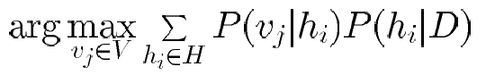
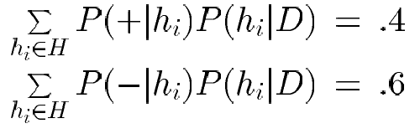
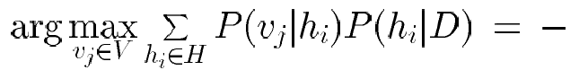
Bayes Optimal Classifier
Bayes optimal classification:
Example:
P(h₁|D) = .4, P(−|h₁) = 0, P(+|h₁) = 1
P(h₂|D) = .3, P(−|h₂) = 1, P(+|h₂) = 0
P(h₃|D) = .3, P(−|h₃) = 1, P(+|h₃) = 0
therefore
and

Slide 7
Gibbs Classifier
Bayes optimal classifier provides best result, but can be expensive if many hypotheses.
Gibbs algorithm:
1. Choose one hypothesis at random, according to P(h|D)
2. Use this to classify new instance
Surprising fact: Assume target concepts are drawn at random from H according to priors on H. Then:
E[error_{Gibbs}] ≤ 2E [error_{BayesOptional}]
Suppose correct, uniform prior distribution over H, then
Pick any hypothesis from VS, with uniform probability
Its expected error no worse than twice Bayes optimal

Slide 8
Naïve Bayes
Given a data point x, what is the probability of x belonging to some class c?

Slide 9
Parameters for Bayes rule
Bayes rule:
For P(X₁….X_{n}|Y=y_{k}) parameters needed are :(2^{n}-1) *2

Slide 10
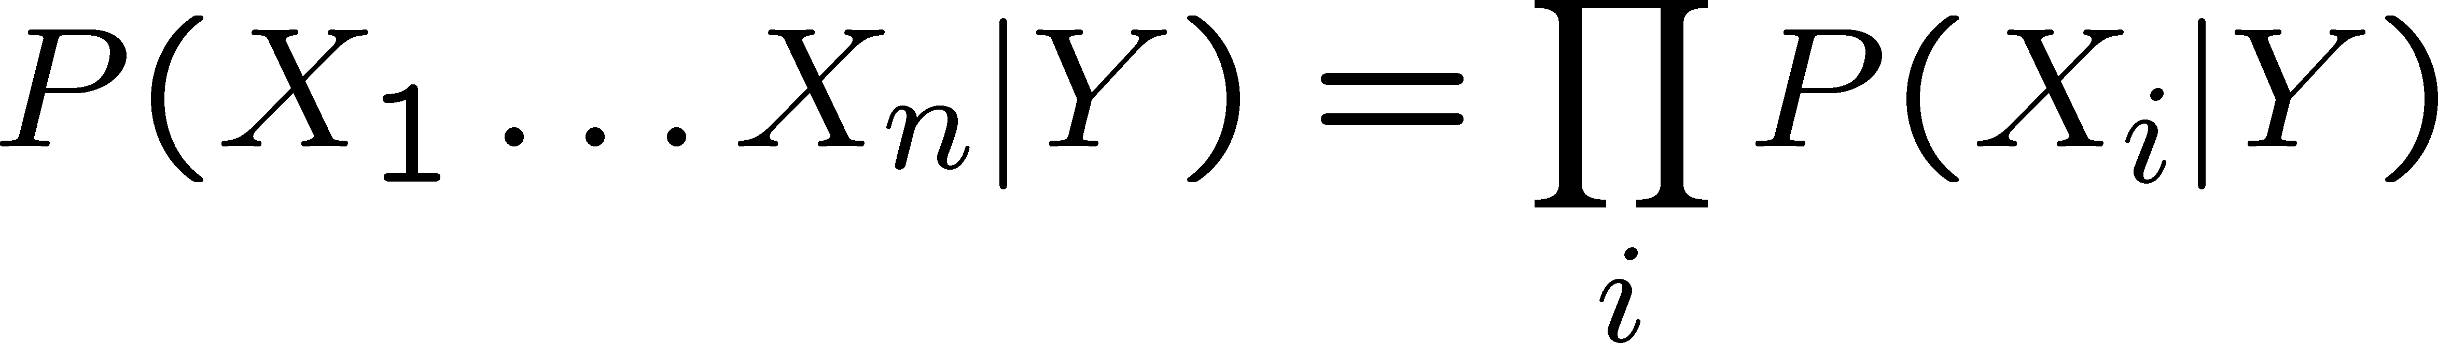
Naïve Bayes
Naïve Bayes assumes
i.e., that X_{i} and X_{j} are conditionally independent given Y, for all i ≠ j

Slide 11
Recall….
Independent Events A and B
Joint Probability distribution of Independent RVs - X and Y
Conditional Probability distribution of Independent RVs - X and Y
P(X,Y) = P(X) P(Y)
P(X|Y) = P(X)

Slide 12
Conditional Independence
Definition: X is conditionally independent of Y given Z, if the probability distribution governing X is independent of the value of Y, given the value of Z
Which we often write
E.g.,

Slide 13
Chain Rule of Probability
Joint probability or product rule
P(A,B) = p(A|B) p(B)
We can extend this for three variables:
P(A,B,C) = P(A| B,C) P(B,C) = P(A|B,C) P(B|C) P(C)
and in general to n variables:
P(A1, A2, ..., An) = P(A1| A2, ..., An) P(A2| A3, ..., An)
P(An-1|An) P(An)

Slide 14
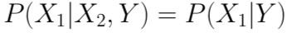

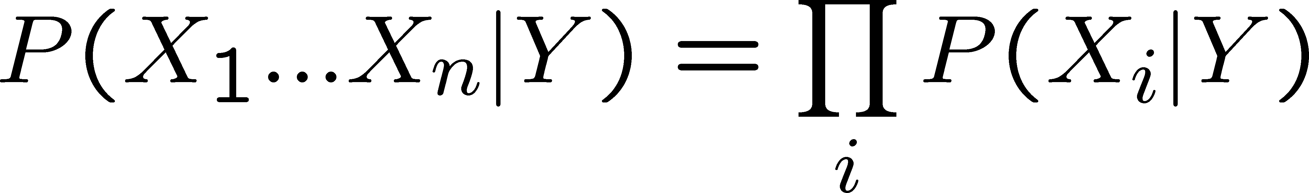
Applying conditional independence
Naïve Bayes uses assumption that the X_{i} are
conditionally independent, given Y. E.g.,
Given this assumption, then:
in general:

Slide 15
Naïve Bayes Classifier
Bayes rule:
Assuming conditional independence among X_{i}’s:
So, to pick most probable MAP Y for X^{new} = < X₁, …, X_{n} >
Prior Probability
MLE

Slide 16
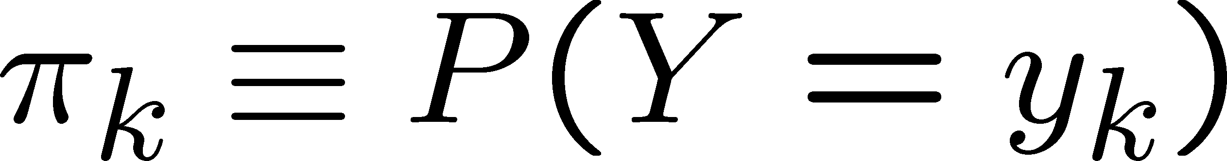
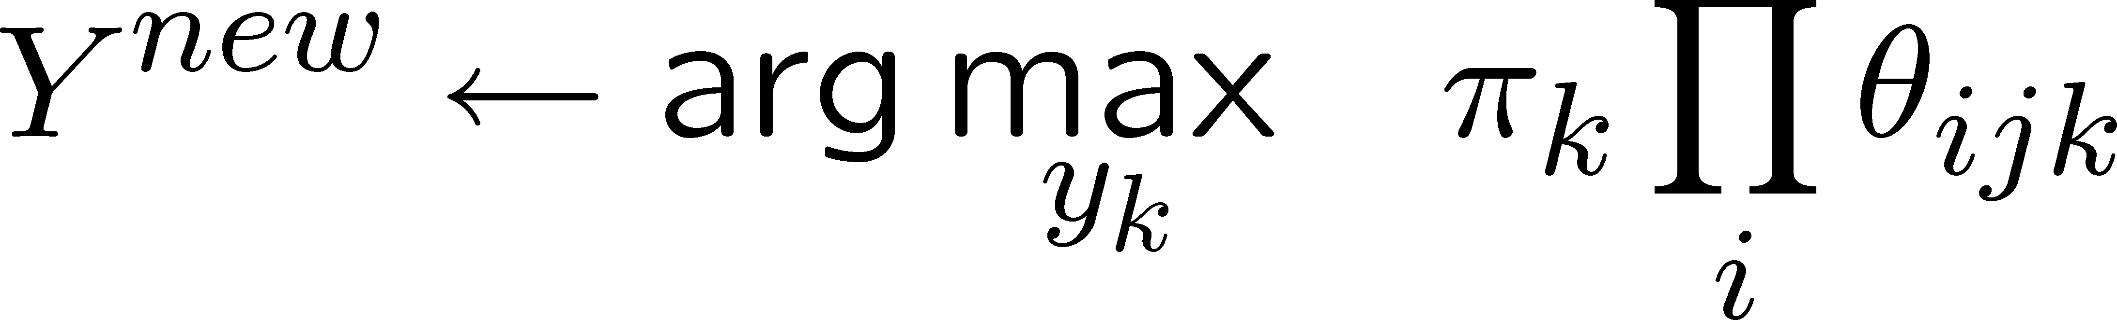
Naïve Bayes Algorithm – discrete X_{i}
Train Naïve Bayes (examples) for each* value y_{k}
estimate
for each* value x_{ij} of each attribute X_{i}
estimate
Classify (X^{new})

Slide 17
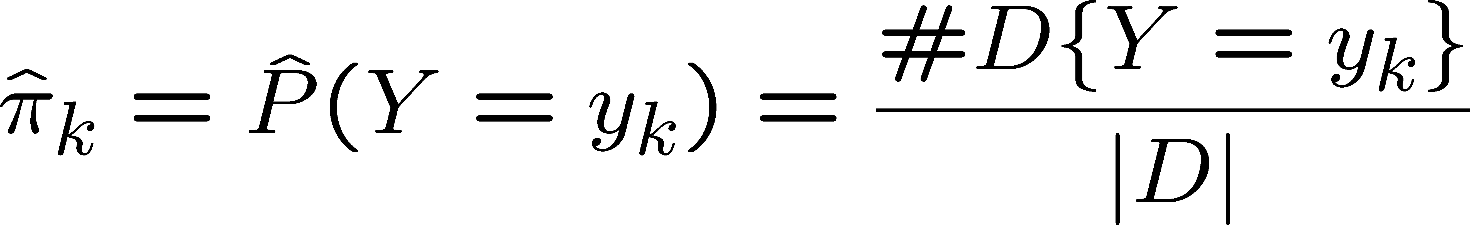
Estimating Parameters: Y, Xi discrete-valued
Maximum likelihood estimates (MLE’s):
Number of items in dataset D for which Y=y_{k}

Slide 18
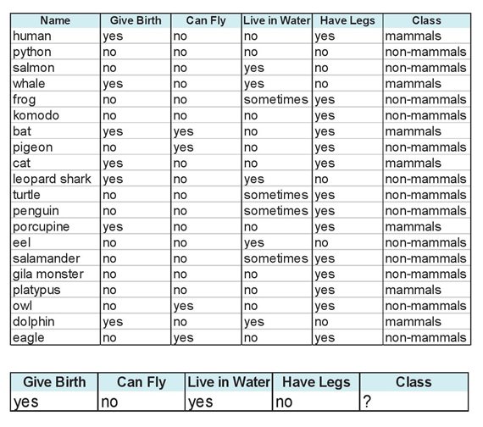
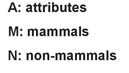
Example 1

Slide 19
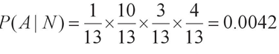
Example 1 - continued

Slide 20
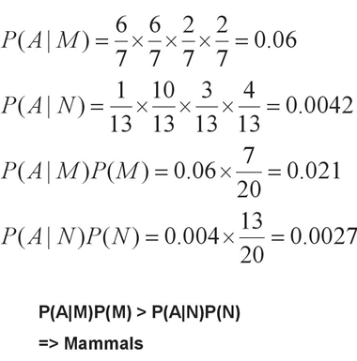
Example 1 - continued

Slide 21
Gaussian Naïve Bayes

Slide 22
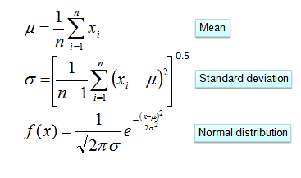
Gaussian Naïve Bayes
Use of normal or Gaussian distributions for numerical variables.
The probability density function for the normal distribution is defined by two parameters (mean and standard deviation).
https://www.kdnuggets.com/2020/06/naive-bayes-algorithm-everything.html

Slide 23
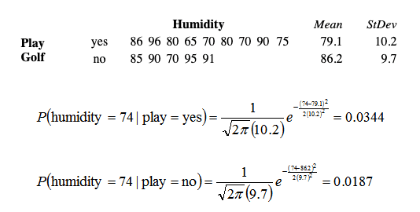
Gaussian Naïve Bayes - example
https://www.kdnuggets.com/2020/06/naive-bayes-algorithm-everything.html

Slide 24
Laplace Smoothing

Slide 25
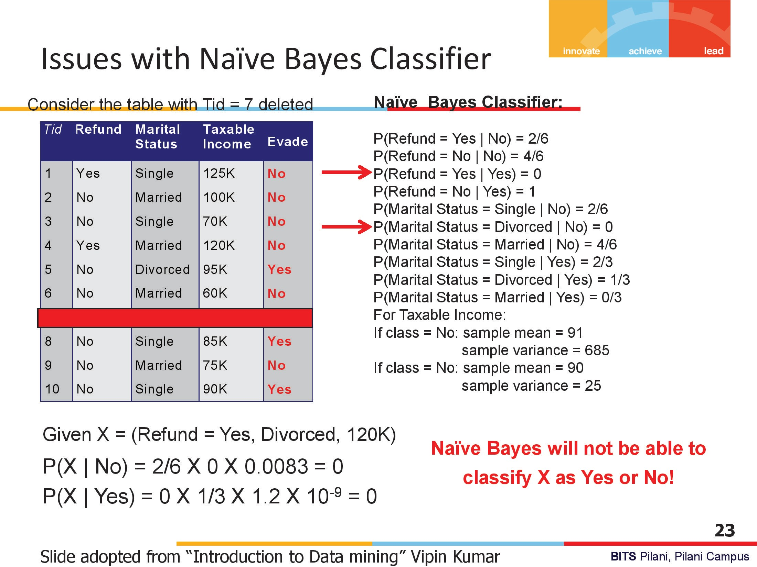

Slide 26
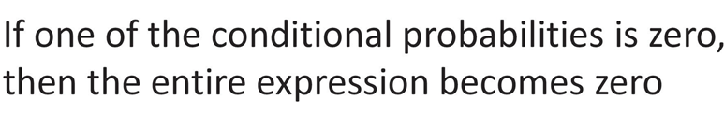
Laplace smoothing
Technique for smoothing categorical data.
A small-sample correction, or pseudo-count, will be incorporated in every probability estimate.
No probability will be zero.

Slide 27
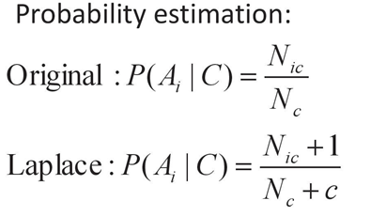
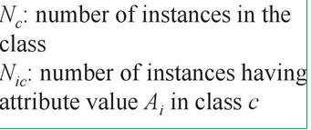
Laplace smoothing
C=number of classes

Slide 28
Applications

Slide 29
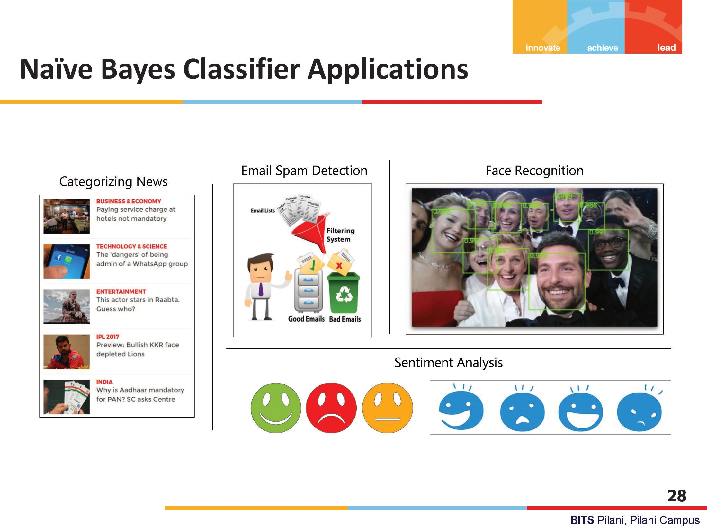

Slide 30
Naive Bayes Classifier
Along with decision trees, neural networks, one of the most practical learning methods.
When to use
Moderate or large training set available
Attributes that describe instances are conditionally independent given classification
Successful applications:
Diagnosis
Classifying text documents

Slide 31
Learning to Classify Text
Why?
Learn which news articles are of interest
Learn to classify web pages by topic
Naive Bayes is among most effective algorithms
What attributes shall we use to represent text documents??

Slide 32
Text Classification using Naive Bayes Classifier
https://web.stanford.edu/~jurafsky/slp3/4.pdf

Slide 33
Learning to classify document: P(Y|X) the “Bag of Words” model
Y discrete valued. e.g., Spam or not
X = <X₁, X₂, … X_{n}> = document
X_{i} is a random variable describing the word at position i in the document
possible values for X_{i} : any word w_{k} in English
Document = bag of words: the vector of counts for all w_{k}’s

Slide 34
The Bag of Words Representation
it | 6
I | 5
the | 4
to | 3
and | 3
seen | 2
yet | 1
would | 1
whimsical | 1
times | 1
sweet | 1
satirical | 1
adventure | 1
genre | 1
fairy | 1
humor | 1
have | 1
great | 1
… | …
I love this movie! It's sweet, but with satirical humor. The dialogue is great and the adventure scenes are fun... It manages to be whimsical and romantic while laughing at the conventions of the fairy tale genre. I would recommend it to just about anyone. I've seen it several times, and I'm always happy to see it again whenever I have a friend who hasn't seen it yet!
15
fairy
it and
always love_{to} ^{it} whimsical it
I
seen
are
anyone
friend
happy
dialogue
adventure
recommend
satirical
_{who}sweet of _{movie}
it I
it ^{I} but ^{to} romantic
several
yet it
again
the
humor
the
seen
would
to scenes I
the manages
fun ^{the} times _{and}
I
and
about
whenever
have
while
conventions with

Slide 35
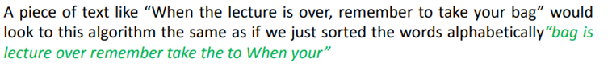
The Bag of Words Representation
Bag of Words assumption: Assume position doesn’t matter

Slide 36
Text Classification
Input:
a document d
a fixed set of classes C = {c₁, c₂,…, c_{J}}
A training set of m hand-­‐labeled documents (d₁,c₁),....,(d_{m},c_{m})
Output:
a learned classifier γ:d → c

Slide 37
Multinomial Naïve Bayes Classifier
For a document d and a class c
Document d
represented as features x1..xn
Conditional Independence: Assume the feature probabilities P(x_{i}|c_{j}) are independent given the class c

Slide 38
Applying Multinomial Naive Bayes Classifiers to Text Classification
positions ←all word positions in test document

Slide 39
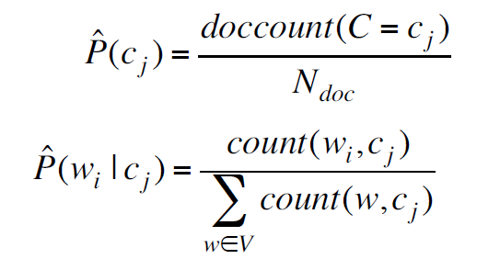
Learning the Multinomial Naïve Bayes Model
fraction of times word w_{i} appears among all words in documents of topic/class c

Slide 40
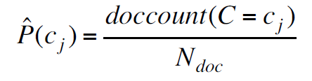
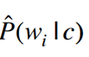
Laplace (add-­‐1) smoothing for Naïve Bayes
Vocabulary ← all distinct words and other tokens in Examples

Slide 41
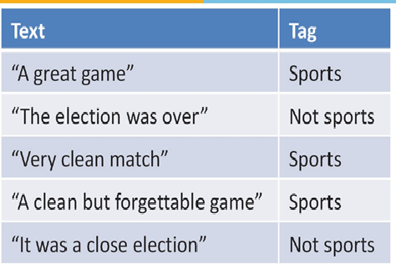
Example 1
Which Tag sentence “ A very close game” belong to?
Apply Naïve Bayes

Slide 42
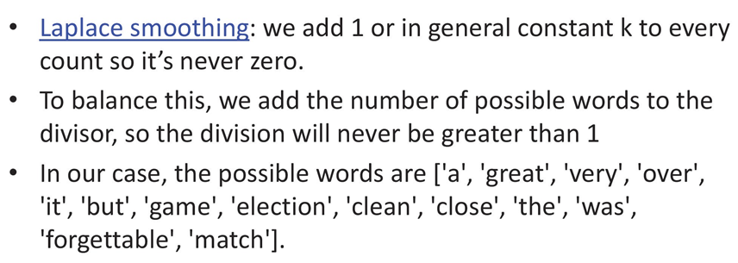
Laplace Smoothing
In our example
we add 1 to every probability, therefore the probability, such as P(close | sports), will never be 0.

Slide 44
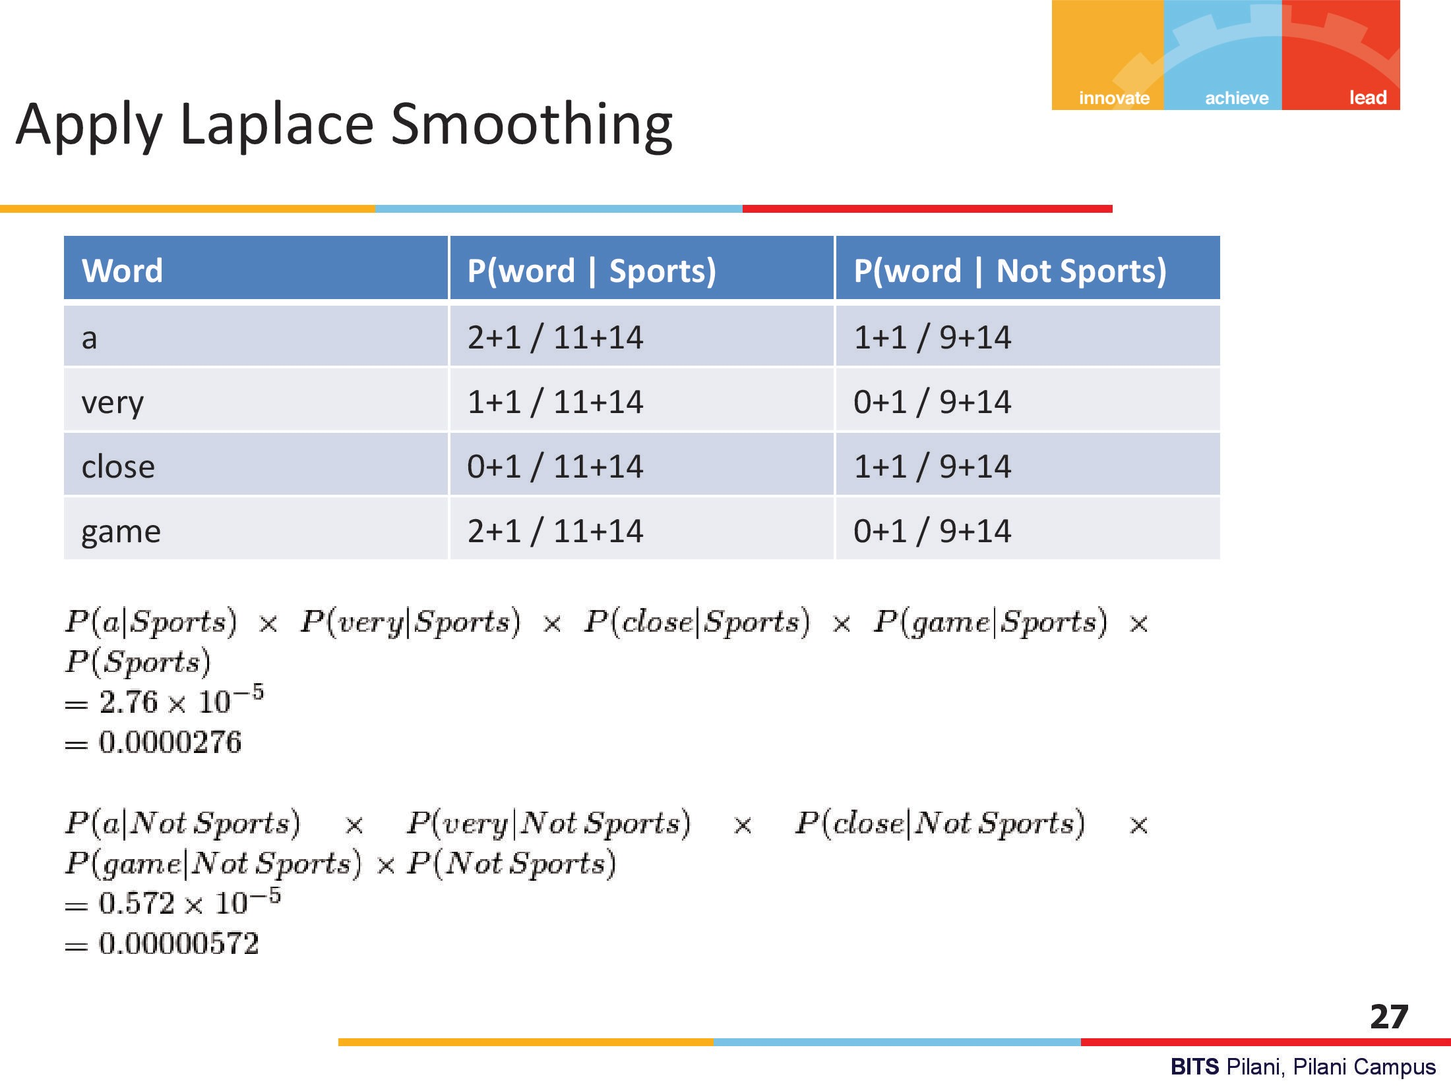

Slide 45
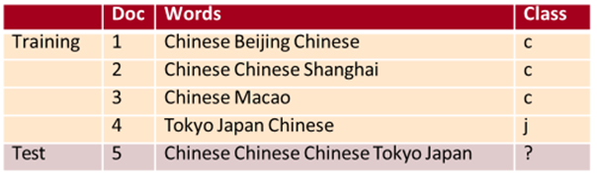
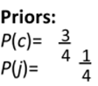
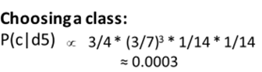
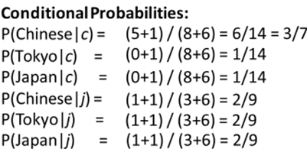
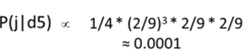
Example 2

Slide 46
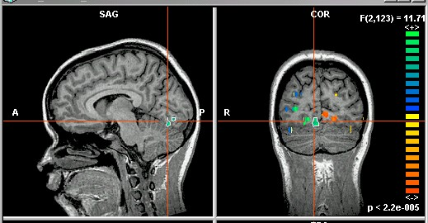
Image classification
X_{i} is real-valued i^{th} pixel

Slide 47
Features of Bayesian learning
Each observed training example can incrementally decrease or increase the estimated probability that a hypothesis is correct.
Flexible approach to learning than algorithms that completely eliminate a hypothesis if it is found to be inconsistent with any single example.

Slide 48
Practical Issues of Bayesian learning
Require initial knowledge of many probabilities
Often estimated based on background knowledge, previously available data, and assumptions about the form of the underlying distributions.
Significant computational cost required to determine the Bayes optimal hypothesis in the general case (linear in the number of candidate hypotheses)

Slide 49
Minimum Description
Length Principle

Slide 50
Minimum Description Length Principle
MDL is an information theoretic model selection principle.
It is an important concept in information theory (the study of the quantification of information) and in learning theory (the study of the capacity for generalization based on empirical data).
MDL assumes that the simplest, most compact representation of the data is the best and most probable explanation of the data.
The first central MDL idea is that every regularity in data may be used to compress that data;
The second central idea is that learning can be equated with finding regularities in data

Slide 51
Minimum Description Length (MDL) Principle
Goal : to find regularity in the data.
‘Regularity’ may be identified with ‘ability to compress’.
MDL combines these two insights by viewing learning as data compression:
It tells us that, for a given set of hypotheses H and data set D, we should try to find the hypothesis or combination of hypotheses in H that compresses D most.
Used in model selection and, more generally, dealing with overfitting.

Slide 52
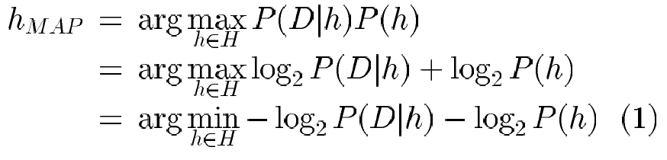
MDL
Motivated by interpreting the definition of h_{MAP} t he light of basic concepts from information theory. Consider h_{MAP}
Interpretation : short hypotheses are preferred, assuming a particular representation scheme for encoding hypotheses and data

Slide 53
MDL
Introduction to a basic result of information theory
consider the problem of designing a code C to transmit messages drawn at random
probability of encountering message i is p_{i}
interested in the most compact code C
Shannon and Weaver (1949) showed that the optimal code assigns
– log₂ p_{i} bits to encode message i
L_{c}(i)≈ description length of message i with respect to C

Slide 54
MDL
where C_{H} and C_{Dlh} are the optimal encodings for H and for D given h, respectively.
The Minimum Description Length (MDL) principle recommends choosing the hypothesis that minimizes the sum of these two description lengths.

Slide 55
Minimum Description Length Principle
C₁ : code to represent the hypothesis
C₂ : code to represent data given the hypothesis
L_{C1}(h) = length(h) = –log₂P(h)
L_{C2}(D|h)= length(misclassifications) = –log₂P(D|h)
→ prefer the hypothesis that minimizes
length(h) + length(misclassifications)

Slide 56
Minimum Description Length Principle
MDL principle provides a way of trading off hypothesis complexity for the number of errors committed by the hypothesis.
May select a shorter hypothesis that makes a few errors over a longer hypothesis that perfectly classifies the training data.
Provides one method for dealing with the issue of overfitting the data.

Slide 57
Decision Theory

Slide 58
Decision Theory
Suppose x is an input vector together with a corresponding vector t of target variables
Goal: predict t given a new value for x.
The joint probability distribution p(x, t) provides a complete summary of the uncertainty associated with these variables.
Determination of p(x, t) from a set of training data is called inference and is a difficult problem.

Slide 59
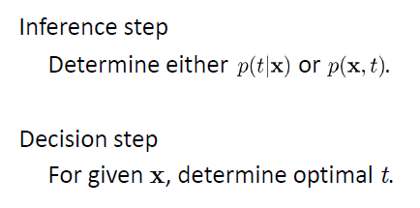
Decision Theory

Slide 60
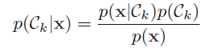
Example : Medical diagnosis problem
Input: X-ray image of a patient
Input vector x is the set of pixel intensities in the image
Output: Presence of cancer = Class C1,
Absence of cancer, = Class C2.
Choose t to be a binary variable such that
t =0 corresponds to C1 and t =1 corresponds to C2.
We are interested in the probabilities of the two classes given the image, which are given by p(C_{k}|x).
Using Bayes’ theorem,

Slide 61
Minimum Misclassification Rate
Divide the input space into regions Rk called decision regions, one for each class, such that all points in Rk are assigned to class Ck
Boundaries between decision regions are called decision boundaries or decision surfaces
A mistake occurs when an input vector belonging to class C1 is assigned to class C2 or vice versa.

Slide 62
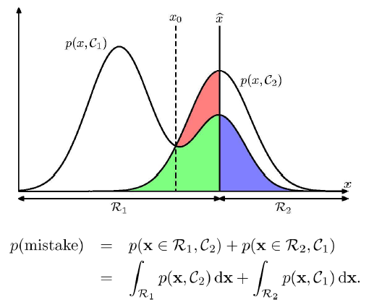
Minimum Misclassification Rate

Slide 63
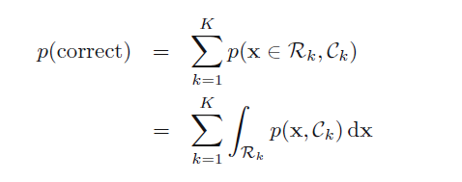
Minimum Misclassification Rate

Slide 64
Inference and Decision
We have broken the classification problem down into two separate stages, the inference stage in which we use training data to learn a model for p(C_{k}|x), and the subsequent decision stage in which we use these posterior probabilities to make optimal class assignments.
An alternative possibility would be to solve both problems together and simply learn a function that maps inputs x directly into decisions. Such a function is called a discriminant function.
Three distinct approaches to solving decision problems

Slide 65
Three distinct approaches to solving decision problems
Solve the inference problem of determining the class-conditional densities p(x|Ck) for each class Ck individually. Also separately infer the prior class probabilities p(Ck). Then use Bayes’ theorem in the form p(Ck|x) = p(x|Ck)p(Ck) / p(x) to find the posterior class probabilities p(Ck|x). Approaches that explicitly or implicitly model the distribution of inputs as well as outputs are known as generative models.
Solve the inference problem of determining the posterior class probabilities p(Ck|x), and then subsequently use decision theory to assign each new x to one of the classes. Approaches that model the posterior probabilities directly are called deterministic or discriminative models.
Find a function f(x), called a discriminant function, which maps each input x directly onto a class label. In this case, probability plays no role.
BITS Pilani, Deemed to be University under Section 3 of UGC Act, 1956

Slide 66
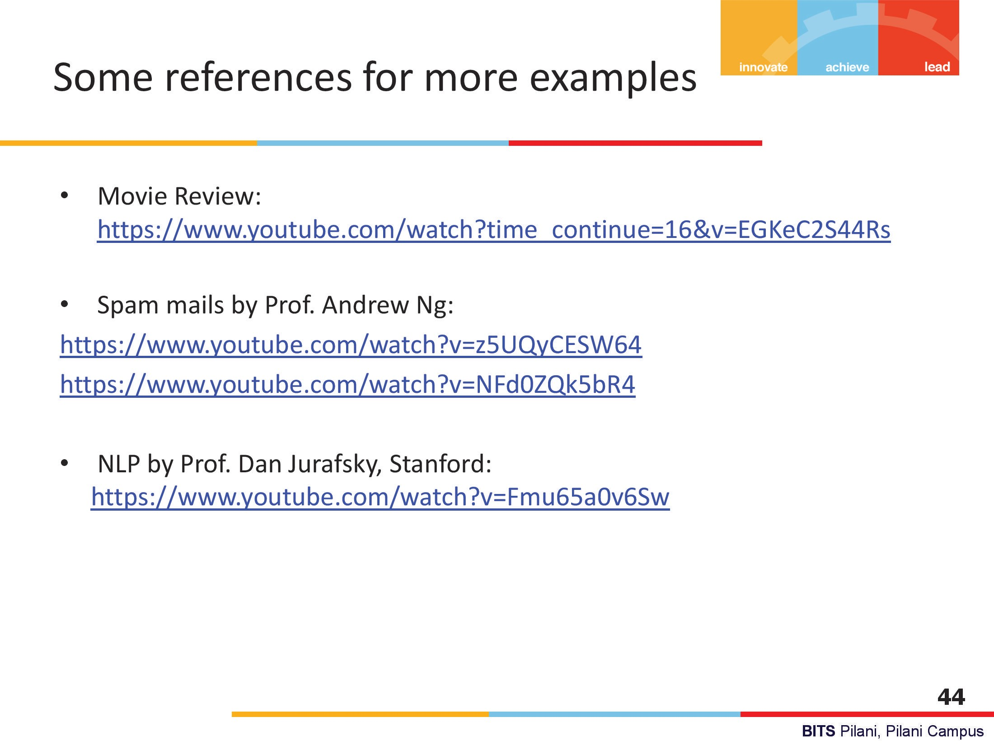

Slide 67
Home work

Slide 68
MLE estimate of Bernoulli Random variable
Find MLE estimate of Bernoulli Random variable X having (X₁, ……, X_{n})
X_{i} ~ Ber(p). Find the optimal value of parameter p.
(Refer Section 2.1 Bishop or https://web.stanford.edu/class/archive/cs/cs109/cs109.1192/reader/11%20Parameter%20Estimation.pdf)

Slide 69
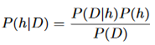
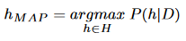
Bayes theorem and Concept Learning
What is the relationship between Bayes theorem and Concept Learning.
It can be used for designing a straight forward learning algorithm.
Brute-Force MAP Learning algorithm
1. For each hypothesis h ∈ H, calculate the posterior probability
2. Output hypothesis with the highest posterior probability

Slide 70
Brute-Force Bayes Concept Learning
H:- a finite hypothesis space defined over the instance space X
c : X → {0,1} :- target concept
some sequence of training examples {<x₁, d₁>, ..., <x_{m}, d_{m}>}
d_{i} = c(x_{i}).
The sequence of instances {x₁, x₂, ..., x_{m}} is held fixed, so that D can be written simply as the sequence of target values {d₁, d₂, ..., d_{m}}.
BITS Pilani, Deemed to be University under Section 3 of UGC Act, 1956

Slide 71
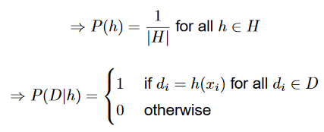
Brute-Force MAP Learning algorithm
in order to specify a learning problem for the algorithm, values for P(h) and P(D|h) must be specified.
Assumptions
Training data, D is noise free (i.e. d_{i} = c(x_{i}))
Target concept c is contained in H i.e.
No reason to believe that any hypothesis is more probable than any other

Slide 72
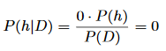
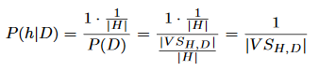
Brute-Force MAP Learning algorithm
h is inconsistent with the training data D
H is consistent with training data D
The above analysis implies that under our choice for P(h) and P(Dlh), every consistent hypothesis has posterior probability
every inconsistent hypothesis has posterior probability 0.
Every consistent hypothesis is, therefore, a MAP hypothesis.

Slide 73
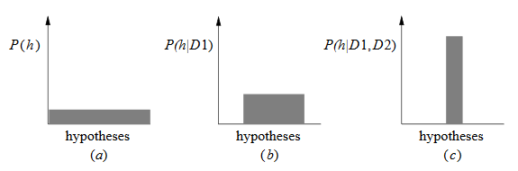
MAP Hypotheses and consistent learnrers
Evolution of probabilities:
all hypotheses have the same probability
+ (c) as training data accumulates, the posterior probability of inconsistent hypotheses becomes zero while the total probability summing to 1 is shared equally among the remaining consistent hypotheses

Slide 74
Thank You

